Slide 1
How to Write a Project Proposal

Slide 2
Contents
What is a project proposal?
Why write a project proposal?
Components of a project proposal
Dos and Don’ts in proposal writing

Slide 3
What is a Project Proposal?
Project proposals present a project by outlining:
  The specific objectives of the project.
  The technical approach to be used in solving the problem or developing the product
  The anticipated results of the project
Project proposals should answer the following questions:
  Is the problem sufficiently important to justify money, time and effort?
  Is the project well defined and realistic?
  Have you outlined a sound approach, including your ability to perform the tasks?

Slide 4
A project proposal can be a selling document written to:
Influence decision-makers.
Convince them to commit time, money or resources in support of a specific project.
A winning proposal addresses an important question with an innovative idea, is well expressed with a clear indication of methods for pursuing the idea, evaluates the findings, and makes them known to all who need to know.

Slide 5
Why Write a Project Proposal?
To inform people or organizations of a project that you would like to implement. A project proposal is much like a business plan.
To apply for a grant.
To ask for other resources or support from another organization.
To explore the causes of a problem and clearly define next steps in solving that problem.

Slide 6

Components of a Project Proposal
Cover Page
Introduction
  History and Definition of the Problem
  Justification and Intervention
Objectives
Intervention Design and Strategy
Activities and Timeline
Budget
Evaluation Indicators
Bibliography

Slide 7
Cover Page
Institution Information
Title (no more than 15 words corresponding to the theme of the intervention)
Author
Date

Slide 8
Introduction
The historical antecedents of the problem and the current situation: Include results or findings of related preliminary studies related to the problem, either national or international.
Description of the problem: Include the description of the current situation and how it got to be that way.
Justification of the Intervention: Clearly define the proposed intervention and justify why this intervention is the best solution to the management problem.

Slide 9
Objectives
Objectives signify the result that you intend to achieve through the intervention. They should directly address the problem mentioned in the problem statement.
Objectives should be SMART:
Specific
Measurable
Achievable
Relevant
Time-bound

Slide 10
Using the SMART Process
Specific. Use Specific rather than generalized language; clearly state the issue, the target group, the time and place of the program.
Measureable. Be clear in the objective about what will be changed and by how much. Setting this clearly at the start makes it easier to evaluate
Achievable. Be realistic about what the program can achieve in terms of the scale/scope of what is being done, the time and resources available.
Relevant. Objectives need to relate to and be relevant to the goals. Remember objectives are the building blocks / steps toward meeting the goals.
Time Specific. Be clear in the objectives about the timeframe in which the program / activities, as well as expected changes, will take place

Slide 11
Intervention Design and Strategy
Describe the intervention, explaining what you propose to do to respond to the problem. It is important to remember that the proposed intervention leads to the objectives that were initially proposed.
Intervention design and strategy should be research based.

Slide 12
Activities and Timeline
Activities includes specific action items under the intervention design.
All activities should be linked to the objectives.
Specify:
  Who will do them
  When they will be done
  How they will be accomplished
  Why you chose this approach
  How long each activity will take

Slide 13
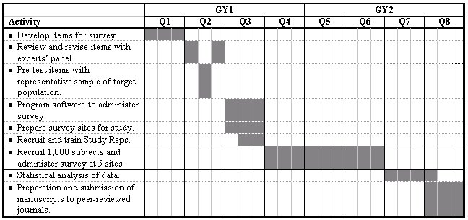
Timeline Example

Slide 14
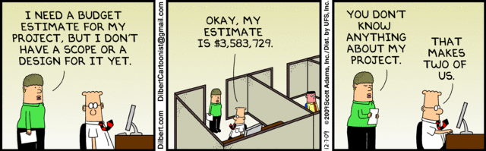
Budget Strategy
Ask for what you need to do the work.
Justify requests that are significant or out of the ordinary.
Develop a budget explanation to delineate clearly how budget figures were computed.

Slide 15
Evaluation Indicators
Clear objectives and activities lead to an evaluation plan – how are you going to know you accomplished what you set out to do?
Choose indicators that will tell you whether or not you achieved your goal and met its objectives.

Slide 16
Logic Models
A Logic Model is a widely used tool that presents specific details of program inputs, activities and outcomes, and shows generally how they are related.
Logic Models can be very helpful in organizing and summarizing your information.
Inputs | Activities | Outputs | Outcomes | Indicators

Slide 17
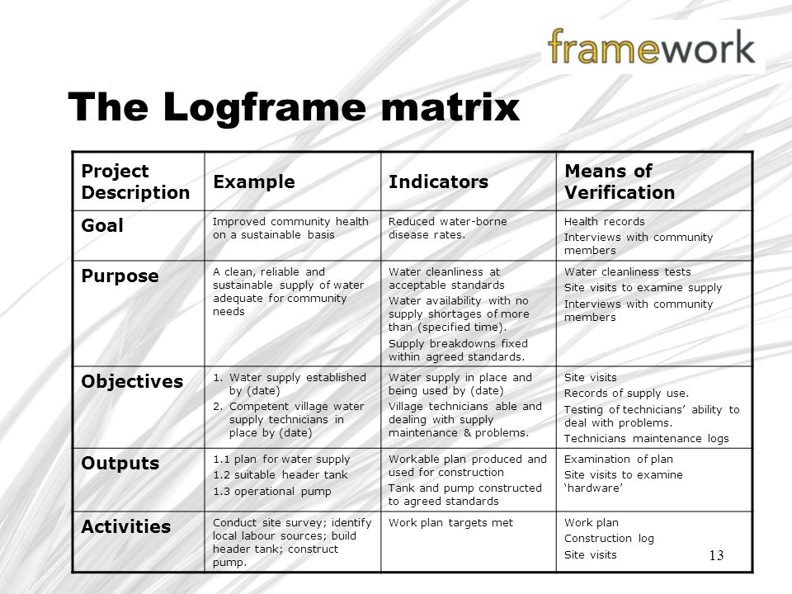
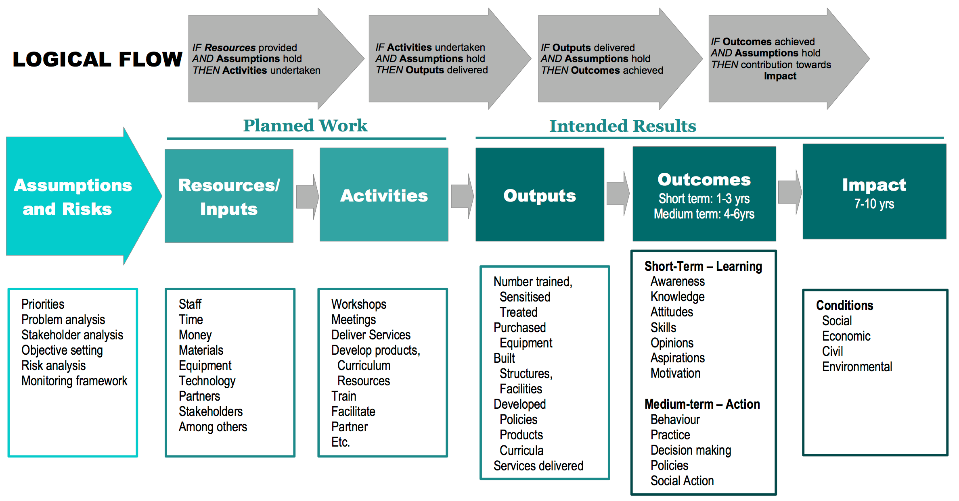
Logic Model Example

Slide 18
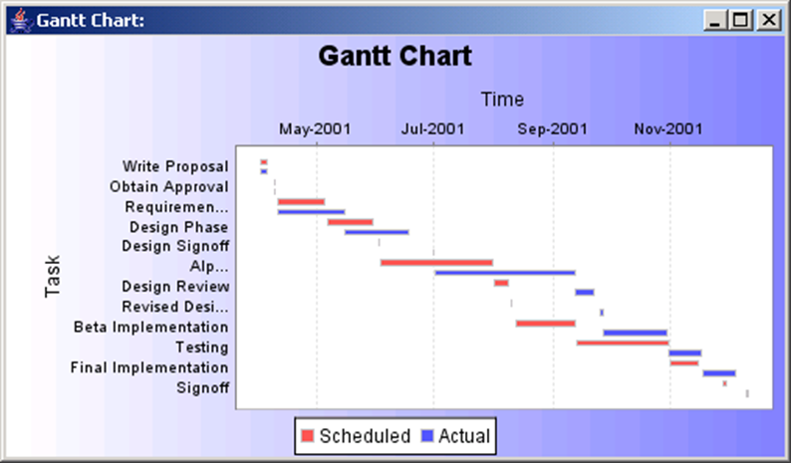

Slide 19
Edu. Funders
CUSO International
Debate Mate
DFATD (CIDA)
Edgechem Jamaica Limited
Gleaner Company Limited
Grace Kennedy Foundation
ICWI Group Foundation
Island Grill
J. Wray and Nephew
Jamaica Association for the Deaf
Jamaica Autism Support Association
Jamaica Public Service Co. Foundation
Jamaica Observer
CITIGROUP
Mutual Building Societies Foundation
National Baking Co. Ltd.
United States Agency for International Development (USAID)
Virginia Jamaica Exchange Foundation/VJEEF
British Council
Digicel Foundation
Flow
Food for the Poor
Chase Fund
Spanish Foundation
JMMB
NCB
Scotia
Palmyra Foundation
Jamaica Broilers Group Foundation
Cari-Med Foundation
RJR Communication Group
Cecil B. Facey Foundation

Slide 20
Dos
Innovative
Relevant
Proposal demonstrates expertise on the issue
Feasible
Show enthusiasm in your writing
Simple, straightforward language
Research based

Slide 21
Don’ts
Project doesn’t address priorities
Ideas are not clearly presented
Ideas are not backed up by statistics and research
Overuse of jargon
Overly ambitious
Narrative and budget don’t correspond
The work has already been done

Slide 22
QUESTIONS?

